Slide 1

General Electric in China
By: Don Nguyen

Slide 2
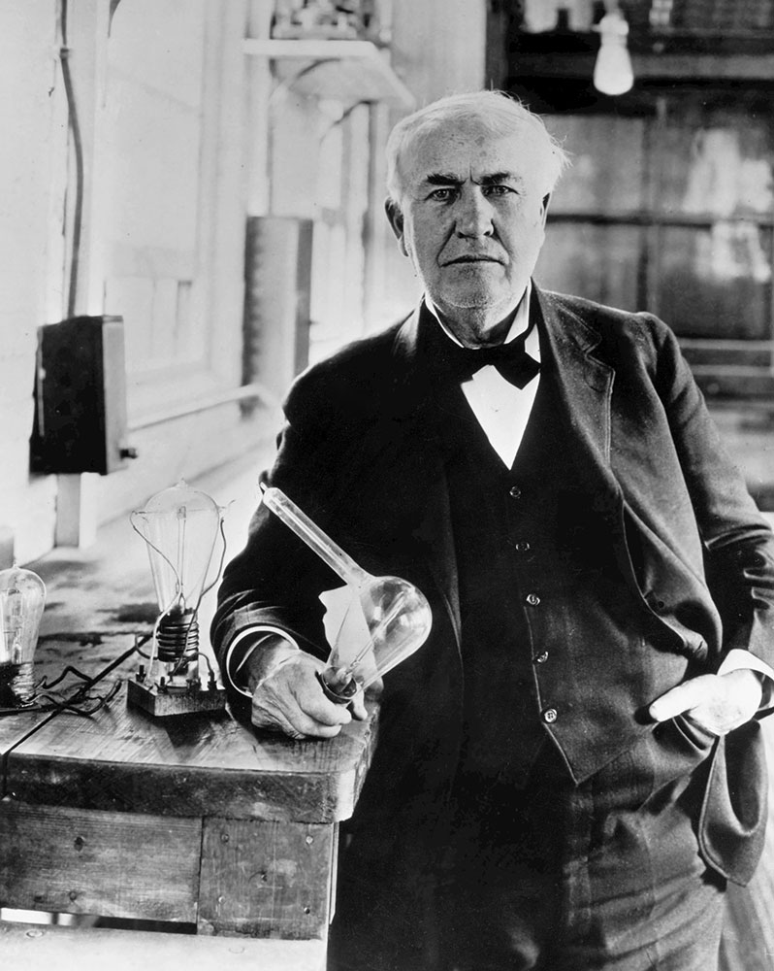
Brief History
Thomas Alva Edison
Founded Edison Electric Light Company in 1878
Known for the phonograph and the lightbulb
Thomson Huston Company
Made similar items as Edison Electric
Rival Company
General Electric
Founded in April 15, 1892, Schenectady, New York
Was a merged between Thomas Edison’s Lab and Thomson-Huston Company
Move to China
Started business in China as early as 1906
Notes:
Phonograph was a voice recording device.
The lightbulb was made with a bamboo filament that allow it to shine for days rather than minutes.
Thomas Edison and Thomson Huston where both rival companies who were a threat to each other. It wasn't until JP Morgan, GE financer, can up with the plan to merge the two company, calling it General Electric.
GE in China was the most active foreign company in China.

Slide 3
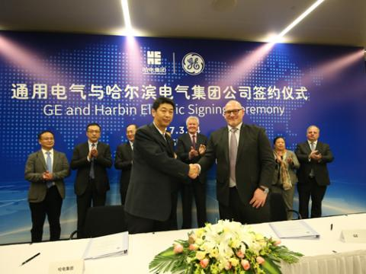
Innovation Centers
Chengdu
1st Innovation Center of GE worldwide
Focus on local healthcare, shale gas drilling technology, industrial automation, green energy, and etc…
Xi’an
2nd Innovation Center in China
Create and find solutions towards lighting, aviation, and energy sectors
Harbin
Created at the Science and Technology Mansion
3rd Innovation Center in China
Was a partnership between Harbin Electric
Notes:
Like many of the other innovation centers, their goal is to provide a joint product and solutions with regional customers. With this, they hope to localized themselves with other companies.

Slide 4
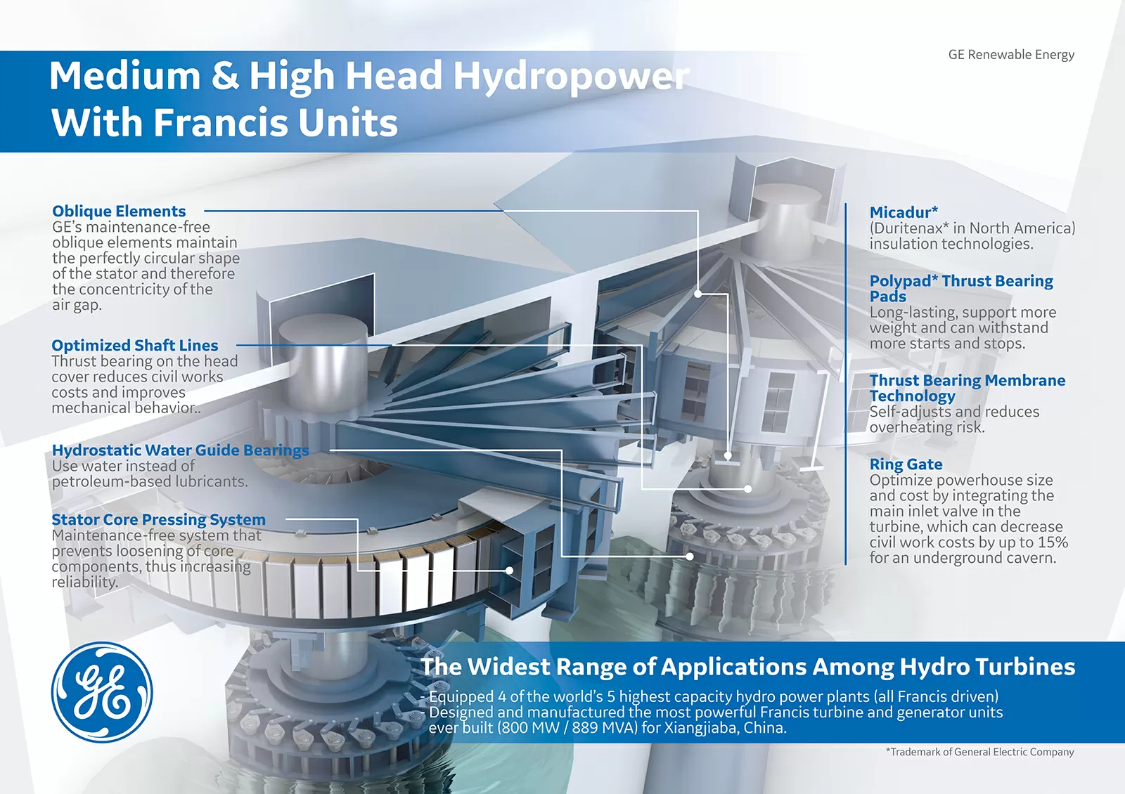
Renewable Energy
GE Wind Energy
2004, first wind turbine introduced
Installed over 1300 wind turbines, providing around 2 million kW
GE Hydro Energy
Founded in 1995, GE Hydropower industrial base located in Tianjin
Leading supplier for China
Manufacture and design hydropower equipment and system
Notes:
With the introduction in and installation of over 1300 wind turbines, it has provided over 46.7 billion kwh of clean energy in China. While oil and gas can same energy output, the down side is that it would create around 460 million carbon dioxide emission.
GE Renewable Energy’s Hydro site, in Tianjin, is used for many things. It is where they design, test, and manufacture new equipment before selling it though China. They build items such as turbines and generators.
GE makes up a near 20% of the market share in China with their hydro company.

Slide 5

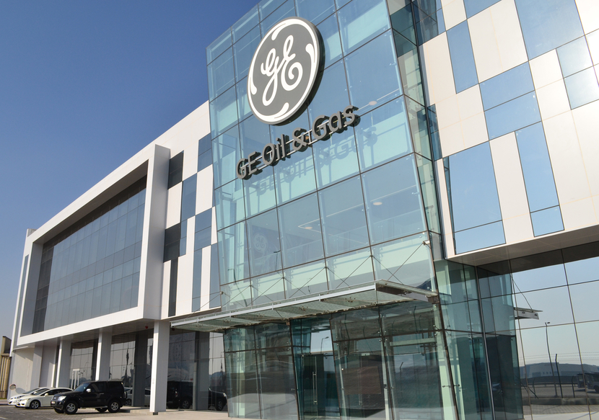
Specialize in gas pipeline, oil refinery, ethylene, coal chemical, and industrial power
Provide China with many resources to get started
Steam turbine, gas turbines, pump values, gas solution technology
West to East Pipeline Project
A 600,000 km-long gas pipeline
Purpose was to bring clean energy to over 1 billion people in 20 provinces

Slide 6
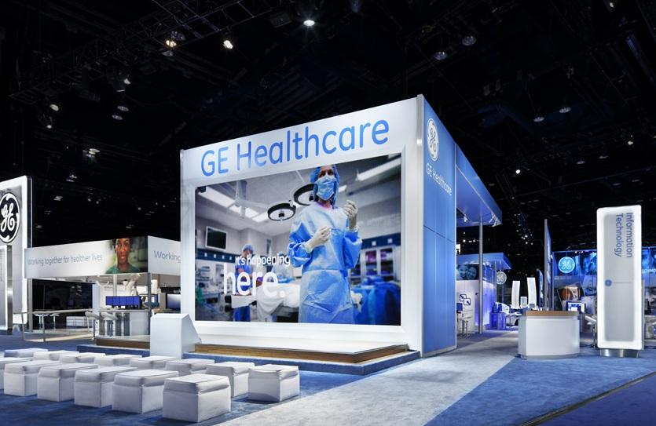
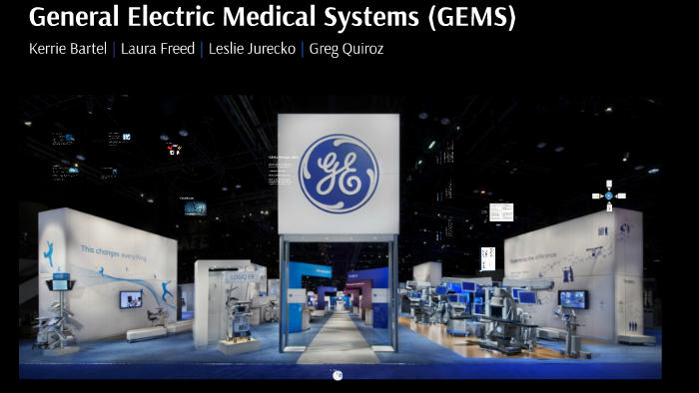
GE Healthcare
Started doing business in China in 1979
First office build in Beijing, 1986
In 1991, formed joint venture with Hangwei Medical Systems Co. Ltd.
Operates in Five Global Manufacturing Sites
Computed Tomography and X-Ray Site in Beijing
Bio-Sciences plant in Shanghai
Ultrasound and patient monitor facilities in Wuxi
Filter paper facility in Tonglu
Magnetic Resonance Imaging in Tianjin
Notes:
GE created their healthcare division with idea of transforming medical equipment. As the demand for better healthcare is rising, GE wants to improve quality and make it more affordable around the world.
In those manufacturing sites, there are more than 7000 employees totaled.

Slide 7


Found in September 2015, the newest addition to GE
GE Digital Foundry in Shanghai
Build in July, 2015, GE invested around $11 million
Designed to incubate startups, improve collaboration and drive ecosystem growth
Formed alliance with China’s Huawei with goals of speeding Predix development
Hope to innovate Industrial Internet application to support China’s transformation
Notes:
Much like other GE branch, GE Digital is finding ways to innovate the digital world.
Predix is a GE industrial IoT software designed to provide secure edge to cloud OT/IT data connectivity, processing, analytics, and services to support applications.
Issues with this Predix is, it has a lot of flaws, and other companies have already perfected cloud connection and etc.

